Slide 1
Lesson objective
Title: Order
Aim – be able to:
order Fractions, Decimals and Percentages FDP's by using our converting knowledge

Slide 2
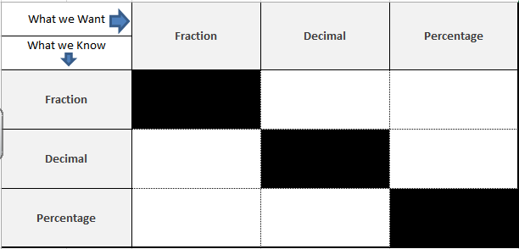

Conversion help sheet
Numerator ÷ Denominator (Bus-stop method)
Create an equivalent fraction with a denominator of 100
Use knowledge of place value. 0.23 (the 3 is 3 hundredths = $\frac{23}{100})$
X 100 (Multiply by 100)
Put over 100 and then simplify and then simplify then simplify by dividing by common factors
÷ 100 (Divide by 100)

Slide 3
Exercise books A - N
Fraction | Decimal | Percentage
1/2 | 0.5 | 50%
3/4 | 0.75 | 75%
1/5 | 0.2 | 20%
1/8 | 0.125 | 12.5%
93/100 | 0.93 | 93%
1/50 | 0.02 | 2%
1/25 | 0.04 | 4%
A
B
C
D
E
F
G
H
I
J
K
L
M
N

Slide 4
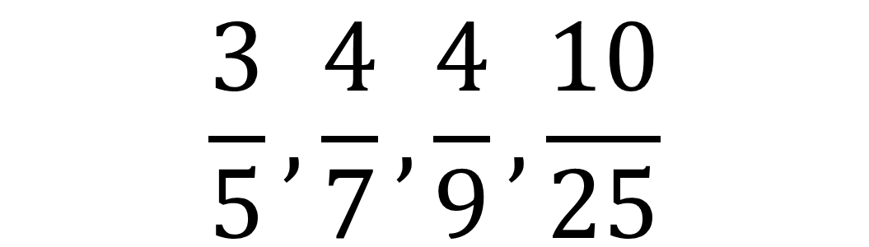
Ordering Fractions
Ordering fractions:
1) Convert everything into decimals
2) Order the decimals
3) Re-write the original
$$\frac{3}{5},\frac{4}{7},\frac{4}{9},\frac{10}{25}$$

Slide 5
Ordering Decimals - Recap
It is easier to put decimals in order if we have the same number of digits after the decimal point.
0.12 0.302 0.5 0.06
Look at the decimals to find which one has the most number of digits after the decimal point.
0.12
0.302
0.5
0.06
Step 1
Add zeros to the other decimals so that they all have this number of digits after the decimal point.
Step 2
0.120
0.302
0.500
0.060
Step 3
Put the numbers in order of size.
0.500
0.302
0.120
0.060

Slide 6
Quick Practice Questions!
Put these decimals in order from highest to lowest:
a)
b)
c)
d)
Challenge:
Can you order to following measurements in ascending order.
121cm 0.46m 79mm 1.42m 1.35km
3.45 | 3.3 | 3.709 | 3.9 | 3.56
2.3 | 2.109 | 2.06 | 2.329 | 2.091
16.7 | 1.067 | 167.01 | 1.78 | 1.682
42.6 | 4.901 | 4.22 | 142.04 | 4.910

Slide 7
Answers
Put these decimals in order from highest to lowest:
a)
b)
c)
d)
Challenge:
Can you order to following measurements in ascending order.
121cm 0.46m 79mm 1.42m 1.35km
3.9 | 3.709 | 3.56 | 3.45 | 3.3
2.329 | 2.3 | 2.109 | 2.091 | 2.06
167.01 | 16.7 | 1.78 | 1.682 | 1.067
142.04 | 42.6 | 4.910 | 4.901 | 4.22
79mm | 0.46m | 121cm | 1.42m | 1.35km

Slide 8
Ordering FDP
We have now practiced converting between FDP and also we have had a recap on ordering decimals.
Now we can order Fractions, Decimals and Percentages.

Slide 9
Ordering FDP:
87% 0.871 ½ 2/3 0.57
NOTE: To turn a percentage into a decimal divide by 100 and to turn a fraction into a decimal divide the numerator by the denominator.
Step 1 – turn all the figures into decimals.
Step 2 – put the decimals in order from smallest to largest.
Step 3 – turn the figures back to their original form.
0.87 0.871 0.5 0.67 0.57
0.5 0.57 0.67 0.87 0.871
½ 0.57 2/3 87% 0.871

Slide 10
Class example - Your turn
56% ¾ 0.871 23% 6/7
Step 1 – turn all the figures into decimals.
Step 2 – put the decimals in order from smallest to largest.
Step 3 – turn the figures back to their original form.
0.56 0.75 0.871 0.23 0.86
0.23 0.56 0.75 0.86 0.871
23% 56% ¾ 6/7 0.871

Slide 11
Activity: Put these numbers into lowest to highest order.
1) | 0.22 | 1/10 | 0.34 | 2/3 | 0.903
2) | 1/10 | 0.507 | 0.320 | 7/9 | 0.12
3) | 1/2 | 45% | 0.9 | 4/10 | 0.3
4) | 0.67 | 61% | 6/10 | 0.067 | 0.601
5) | 1.45 | 142% | 3/2 | 107% | 1.024
6) | 1.92 | 7/3 | 193% | 1.899 | 5/2
Challenge 1: | 0.003 | 3/100 | 0.03% | 3/10 | 0.303%
Challenge 2: | 7/4 | 74% | 7.4 | 4/7 | 70.4

Slide 12
Answers (Lowest to Highest)
1) | 1/10 | 0.22 | 0.34 | 2/3 | 0.903
2) | 1/10 | 0.12 | 0.320 | 0.507 | 7/9
3) | 0.3 | 4/10 | 45% | 1/2 | 0.9
4) | 0.067 | 6/10 | 0.601 | 61% | 0.67
5) | 1.024 | 107% | 142% | 1.45 | 3/2
6) | 1.899 | 1.92 | 193% | 7/3 | 5/2
Challenge 1: | 0.03% | 0.303% | 0.003 | 3/100 | 3/10
Challenge 2: | 4/7 | 74% | 7/4 | 7.4 | 70.4

Slide 13
Verbal Feedback
 | 75% + 0.75 + 3/4 + | I can confidently convert Fractions, Decimals and Percentages and I am able to order them.
 | 50 - 75% 0.5 - 0.75 1/2 - 3/4 | I need practice on converting Fractions, Decimals and Percentages which I can use to order them
 | 50% - 0.5 - 1/2 - | I need to look back at my notes on converting between Fractions, Decimals and Percentages

